Slide 1


Data Governance @ SneakerPark
Prepared by: Duy Le Khanh
Submitted on: 09/18/2024

Slide 2
Background
SneakerPark is an online shoe reseller that allows people to buy and sell used and new shoes. Buyers can bid for shoes or buy them outright, and sellers can set a price or sell to the highest bidder.
Each buyer and seller must have an active account in order to sell, bid, or purchase sneakers using SneakerPark’s website.
SneakerPark authenticates the shoes before shipping them to the buyer, so before listing an item, the seller must ship it to SneakerPark’s warehouse. Upon receipt, SneakerPark assigns an item number to each pair of sneakers and notifies the seller that they are now free to list their item. If the item is not listed within 45 days, SneakerPark returns it to the seller and sends an invoice to the seller for the shipping cost.
If the item is found to be inauthentic or in an unacceptable condition, it is also returned back to the seller in a similar fashion.
When the item sells, the buyer’s account is credited with the purchase price minus the SneakerPark service fee and shipping fees to deliver the item to the buyer.
Currently, SneakerPark only supports sales within the United States.

Slide 3
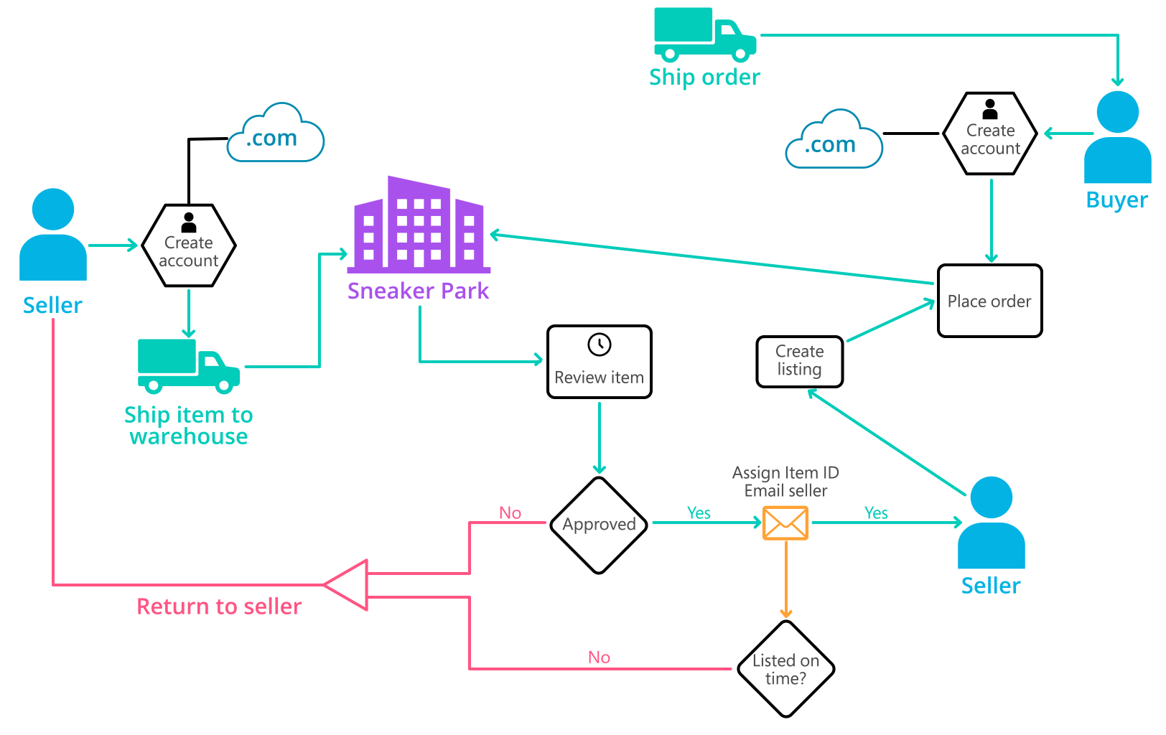
Background (cont’d)
Below you can see a diagram that will hopefully help you visualize some of SneakerPark's business processes. Keep in mind that it does not capture ALL processes and every nuance, but simply serves as another artifact to use in your project.

Slide 4
Step 1
Enterprise Data Catalog Part 1: Enterprise Data Model

Slide 5
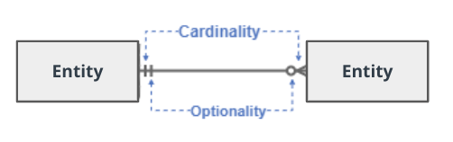
Create a conceptual data model that will provide SneakerPark with a holistic view of its data systems and help you grasp the organization's important entities and relationships, which will be instrumental as you move further in the project. You can use Lucidchart or any other diagramming tool of your choice, but please use the Crow’s Foot/IE Notation and please be sure to indicate both cardinality (the type of a relationship such as 1:N or N:N) and optionality (whether the relationship is optional or mandatory).

Slide 6
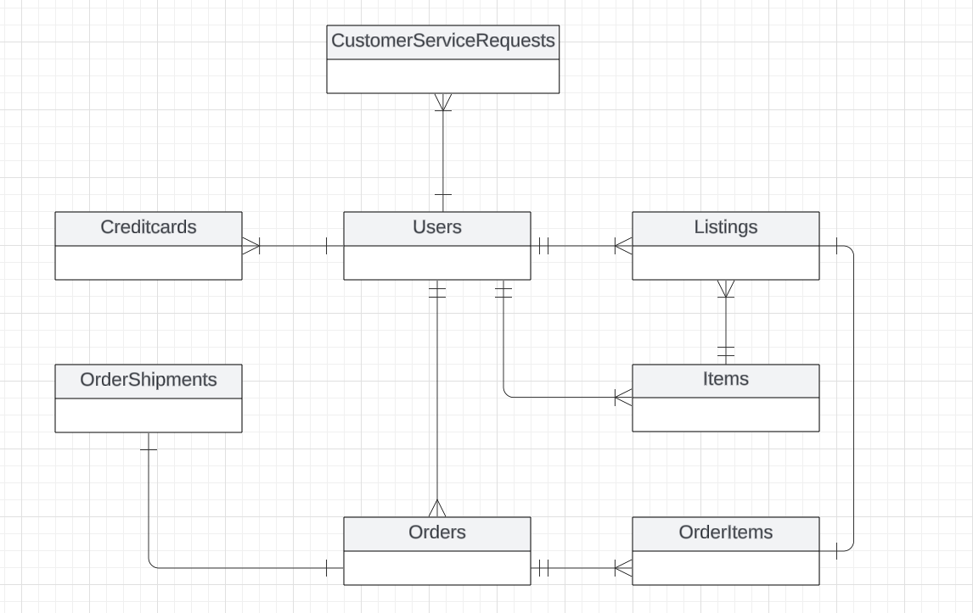
Replace the example below with your own solutions (obviously feel free to take more space):

Slide 7
Step 2
Enterprise Data Catalog Part 2: Metadata

Slide 8
Create the first version of the Metadata Catalog by documenting the metadata from all systems in the "Data Dictionary" and the “Enterprise Data Catalog” tabs of the provided Sheets template.
Please note that you are required to fill out all fields in both tabs.

Slide 9
Step 3
Data Quality
Part 1: Profiling and Cleansing

Slide 10
Profile the data to identify at least 3 data quality issues you see in the data. Also provide at least 1 data quality issue that you haven’t yet seen in the data, but can foresee occurring in the future. Based on the issues you’ve identified, come up with the data quality rule for each data quality issue, including for the one that you foresee.
Make sure you fill out all columns in the "Data Quality Issues" tab with your answers in the provided Sheets template.

Slide 11
Step 4
Data Quality
Part 2: Monitoring

Slide 12
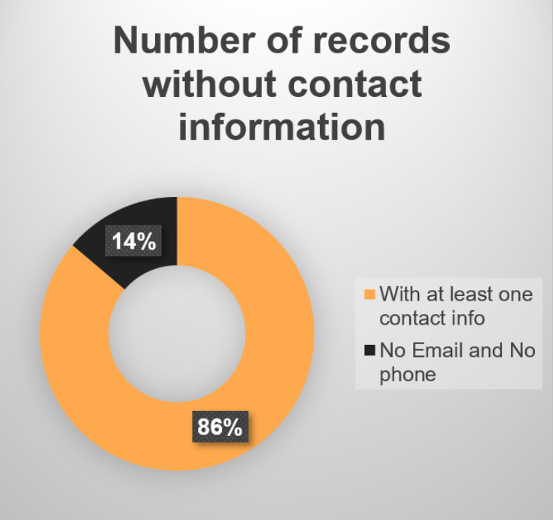
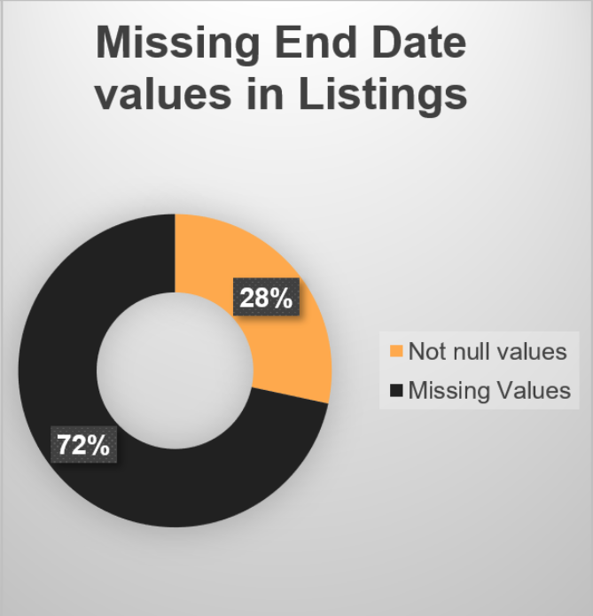
Using the metrics you've created in the last step, please create a mock-up of a data quality monitoring dashboard that will be used to monitor the data to ensure compliance with your data quality rules.
Please make sure to label your metrics clearly on your mock-up.
Replace the example dashboard below with your own. (obviously feel free to take more space).

Slide 13
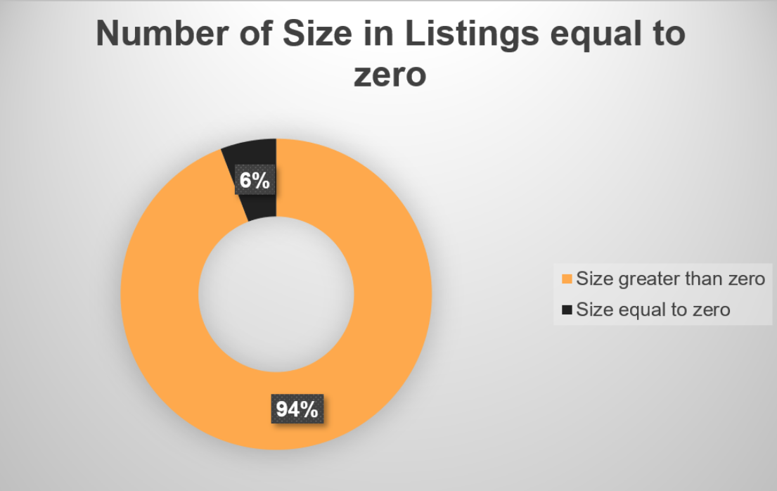
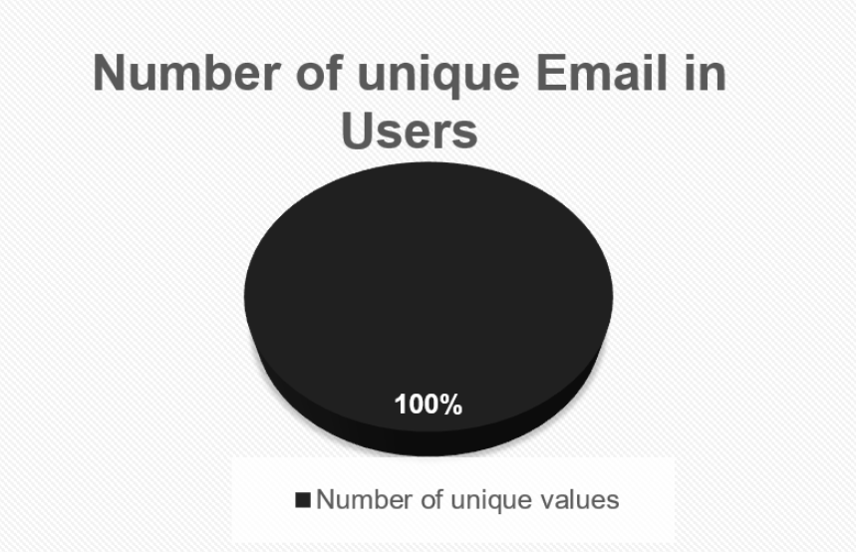
Using the metrics you've created in the last step, please create a mock-up of a data quality monitoring dashboard that will be used to monitor the data to ensure compliance with your data quality rules.
Please make sure to label your metrics clearly on your mock-up.
Replace the example dashboard below with your own. (obviously feel free to take more space).

Slide 14
Step 5
Master Data Management
Part 1: MDM Architecture

Slide 15
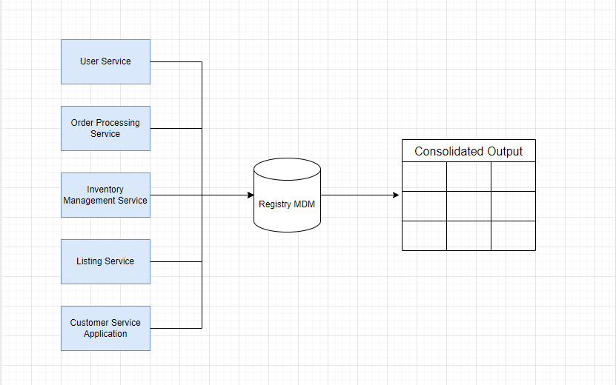
Based on what you’ve read about SneakerPark’s systems and business model, sketch out a proposed MDM implementation architecture, and write a detailed explanation of why you chose this specific approach.
Tip: Think about how your plan and its implementation might affect existing systems.
Replace example screenshot below with your own solutions (obviously feel free to take more space).
Next, please write at least a paragraph explaining your choice.

Slide 16
Why this Architecture?
Scalability: The hub-and-spoke model allows the MDM system to scale as SneakerPark’s business grows.
Data Consistency: Centralizing master data in the hub ensures consistency across systems, reducing data duplication and ensuring accurate reporting and analytics.
Data Governance: The MDM Hub provides a single point of control for data governance, ensuring compliance with regulatory standards and data quality metrics.

Slide 17
Step 6
Master Data Management
Part 2: Master Record

Slide 18
In this step, you will define a set of matching rules that will be used by the SneakerPark's MDM Hub to match item and customer entities between the company's different systems.
Please come up with 4 rules - 2 for Items and 2 for Customers and list them below.
Table | Rules
Item | Same ItemName & SellerID. Match ItemID records on the ItemName from Item & SellerID from Listings.
Item | BrandName, ArrivalDate, SellerID. Match ItemID records on the Brand Name and Arrival Date from Item and Seller ID from Listings.
Customer | LastName, CreditCardNumber CreditCardExpirationdate. Match UserID records on the LastName of Users and CreditCardNumber and CreditCardExpirationDate from Credit Cards.
Customer | Email and OrderID. Match UserID records on the Email from Users and OrderID from Customer Service Requests.

Slide 19
Step 7
Data Governance:
Roles and Responsibilities

Slide 20
Write 1-2 paragraphs discussing what data governance roles and responsibilities will be necessary to oversee this new Data Management initiative. Please be sure to discuss the responsibilities in the context of at least 3 different aspects of Data Governance (such as Data Quality Management, Metadata Management, MDM, etc). Based on what you know, do SneakerPark's current employees have the necessary skills for these roles or should the company make new hires?
To ensure SneakerPark's Data Management initiative is successful, specific roles and responsibilities must be assigned to ensure the seamless operation of critical aspects like Data Quality Management, Metadata Management, and Master Data Management (MDM). For Metadata Management, the Data Steward will be responsible for maintaining and updating SneakerPark’s data dictionary and business context in case of new additions (e.g., new tables or columns) or changes in business descriptions. Given her business knowledge and organizational understanding, Jessica can take on this role. However, due to her existing responsibilities, a new hire should join her to help manage the workload effectively. Together, they would ensure business metadata remains updated and relevant.

Slide 21
Write 1-2 paragraphs discussing what data governance roles and responsibilities will be necessary to oversee this new Data Management initiative. Please be sure to discuss the responsibilities in the context of at least 3 different aspects of Data Governance (such as Data Quality Management, Metadata Management, MDM, etc). Based on what you know, do SneakerPark's current employees have the necessary skills for these roles or should the company make new hires?
For Data Quality Management and Master Data Management (MDM), the Data Architect should define workflows and establish architectures that can automate the identification of data quality issues and breaches. Daniel Freitas, as an experienced data architect, is well-suited for this role and can leverage his expertise to design these systems for SneakerPark. Additionally, the Data Engineer focused on ProdOps will be responsible for providing IT production support to ensure the continued consistency, accuracy, and timeliness of the data. Jake, with his background in IT production support, would be the ideal person for this role, ensuring the operational aspects of data quality and MDM remain functional at all times. Together, these roles will provide a solid framework for SneakerPark's data governance initiative, ensuring that the company effectively manages its data assets.

Slide 22
Standout Suggestions

Slide 23
Create a Business Glossary for SneakerPark and define common terms such as Item, Buyer, etc. Think and discuss how SneakerPark can improve on the consistency of the terms that its systems currently use. (You can use the “Business Glossary” tab of the same Sheets template you’ve been using for the other parts of this project to get you started.)
Document SneakerPark’s current naming conventions. Can you think of any improvements? (You can use the “Standard Naming Conventions” tab of the same Sheets template you’ve been using for the other parts of this project to get you started.) Some examples of Naming Conventions include;
Do not use spaces or special characters.
Use only LOWERCASE.
All identifier fields should end in “_id”.
Avoid acronyms and abbreviations.
Write SQL scripts for the matching rules that you’ve created in Step 6.

